Slide 1
Scalar and Vector Fields
The Scalar Field are functions which assigns a scalar at each point.
The Vector Field assigns a Vector at each point.
Example:
In Physical sense, Temperature at each point in space is the best example of scalar field. For Vector Field there are too many of them like Gravitational Field, Electric Field, Magnetic Field etc.
Mathematical Representation
Scalar field in 3D space are just written mathematically as
Consider a Temperature function on Space
T=f(x,y,z)T=f(x,y,z)
For Vector Field , since it has direction attached to it at every point it is often mathematically written as
E⃗ =P(x,y,z)i+Q(x,y,z)j+R(x,y,z)kE→=P(x,y,z)i+Q(x,y,z)j+R(x,y,z)k
What it does is actually represent the Vector (at each point) in components forms of xyz coordinate system and i,j,k representing unit Vector in respect

Slide 2
Gradient of a Scalar Field
Gradient tells you how fast a function is changing it's value. In general it tells the direction along which you will encounter the maximum change of the value of the function.

Slide 3
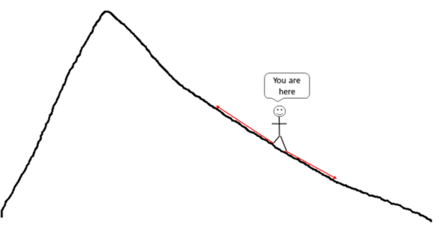
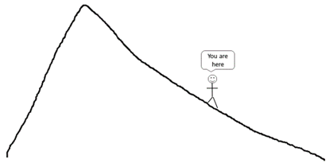
Gradient of a Scalar Field
PHYSICAL INTERPRETATION OF GRADIENT
Now, you have to move in a certain direction to gain or lose altitude (shown in red arrows). These vector lines represent the gradients at your point of location in 2D:
For better understanding of gradient representation in 2D, consider that you are climbing a mountain. You are a certain point on the mountain:
In 2D format, Gradient are tangents representing the direction of steepest descent or ascent.

Slide 4
Gradient a Vector Quantity
What is very important to understand here is though Temperature is a scalar quantity, the Temperatures difference measured over particular direction is a Vector quantity(memorized as T is a scalar while dT as Vector though not entirely true). However the quantity (dT/dx) ,(dT/dy) and (dT/dz) are inherently Vector. And we are measuring the rate of increase (or decrease) in Temperature as we move along x axis , y or z axis respectively. We could if we needed , measure (dT/some arbitrary direction) in an arbitrary direction in space. And what Gradient actually does is considering all these directional increase and instead giving us the increase(or decrease) in the direction of greatest change.

Slide 5
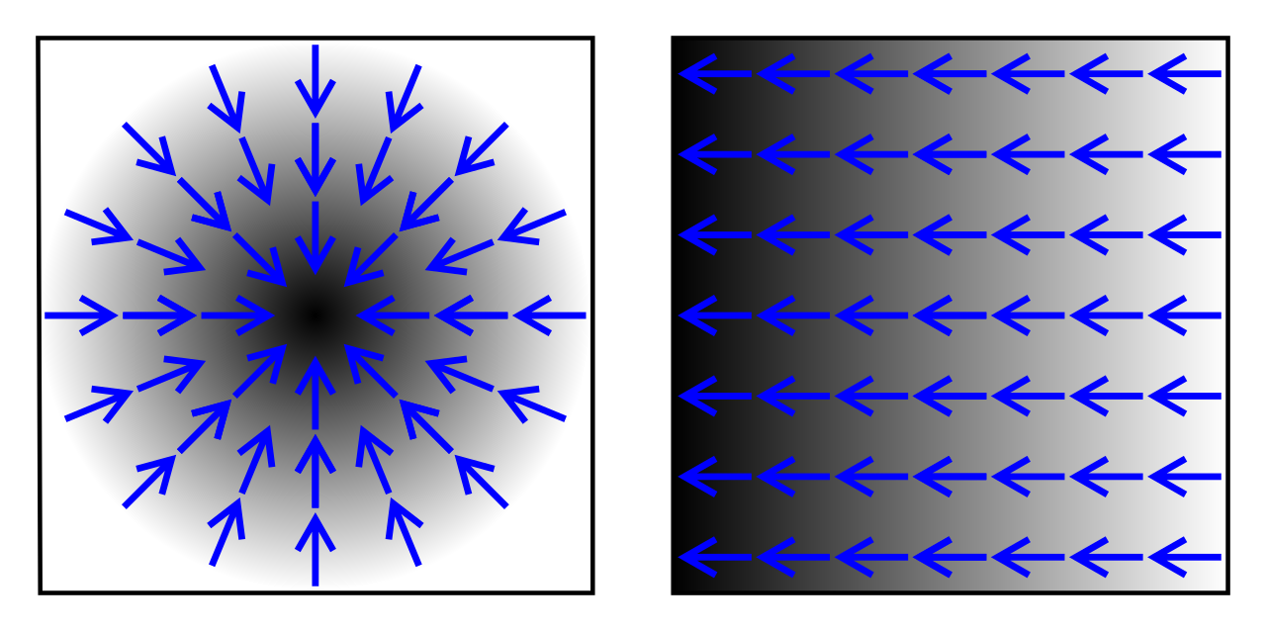

Slide 6
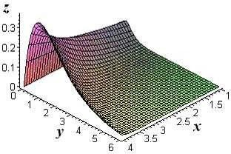
PHYSICAL INTERPRETATION OF
GRADIENT
The gradient also describes directions of maximum change in other contexts. If we have a graph of some function z = f(x, y), In this case we can think of the graph as a surface whose points have variable heights over the x y – plane.
An illustration is given below.
If, say, we place a marble at some point
(x, y) on this graph with zero initial force, its motion will trace out a path on the surface, and in fact it will choose the direction of steepest descent.
This direction of steepest descent is given by the negative of the gradient of f. One takes the negative direction because the height is decreasing rather than increasing.

Slide 7
GRADIENT OF A SCALARFIELD
The gradient of a scalar function f(x₁, x₂, x₃, ..., x_{n}) is denoted by ∇f or where ∇ (the nabla symbol) denotes the vector differential operator, del. The notation "grad(f)" is also commonly used for the gradient.
In 3-dimensional
cartesian
coordinate
system
it is
denoted by:
∇f = i ^{∂f}
+_{j} ∂f _{+ k} ∂f
∂x ∂y ∂z
₌ ∂f _{i +} ∂f _{j +} ∂f _{k}
∂x ∂y ∂z

Slide 8
Differentiation of vector fields
Example of a vector field: Suppose fluid moves down a pipe, a river flows, or the air circulates in a certain pattern. The velocity can be different at different points and may be at different time.
The velocity vector F gives the direction of flow and speed of flow at every point.
Applications of Vector Fields:
Mechanics
Electric and Magnetic fields
Fluids motions
Heat transfer
There are two kinds of differentiation of a vector field F(x,y,z):
divergence (div F = ∇ . F) and
curl (curl F = ∇ x F)

Slide 9
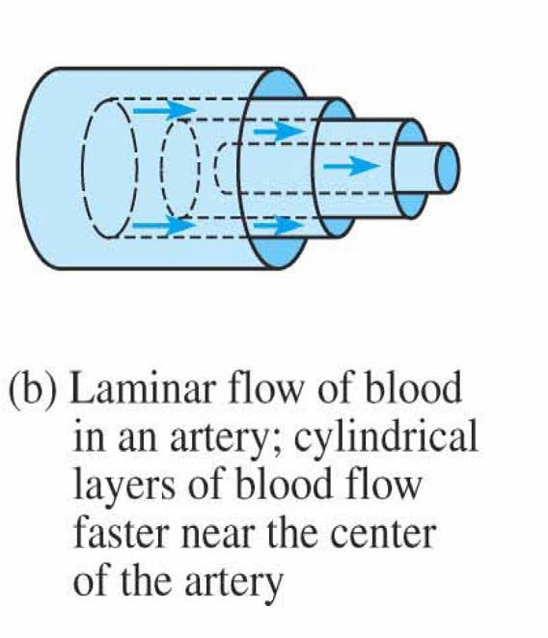
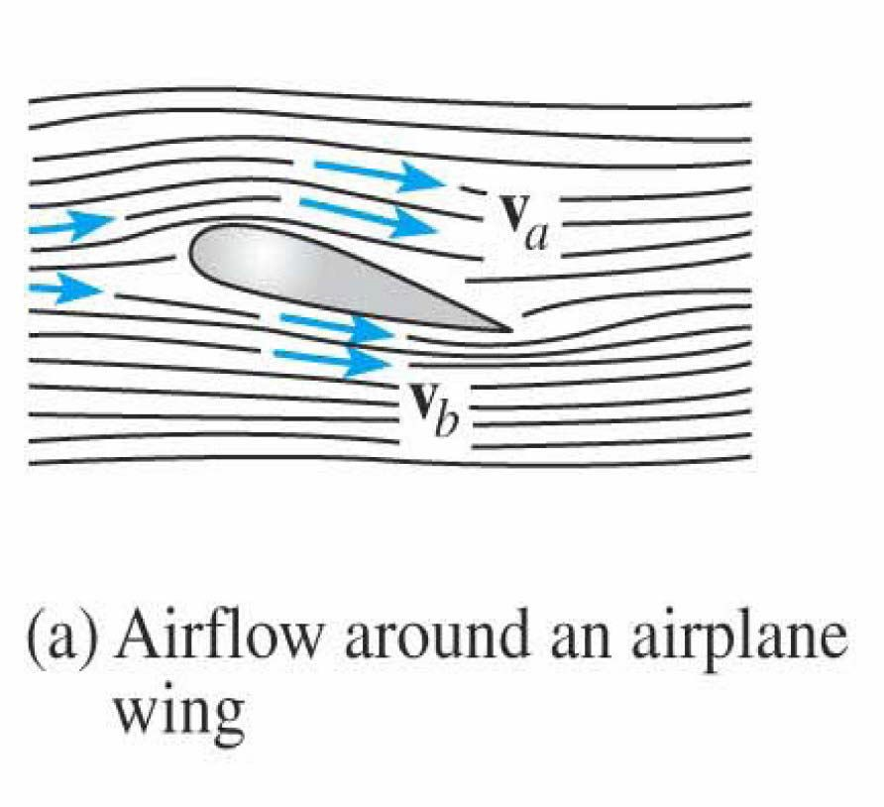
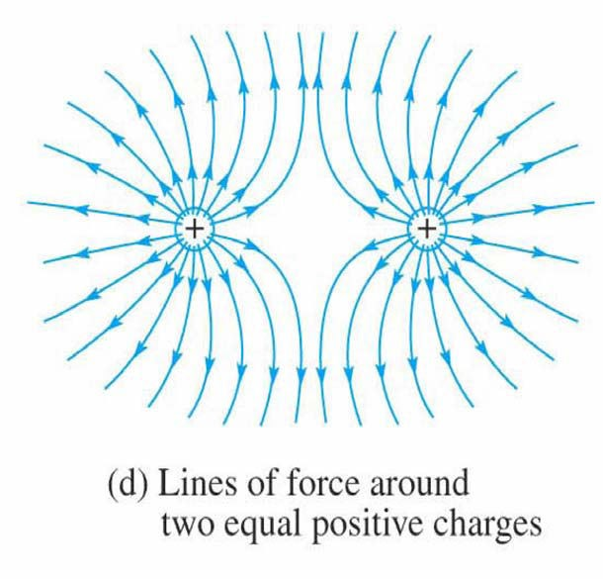
Examples of Vector Fields
3

Slide 10
Physical Interpretation of the Divergence
Physically the divergence of a vector quantity represents the rate of change of the field strength in the direction of the field.
Divergence is a scalar that the rate of change of the spreading out, or dilatation of vector field.
DMore technically, the divergence represents the volume density of the outward flux of a vector field from an infinitesimal volume around a given point.
If the divergence of the vector field is positive at a point then something is diverging from a small volume surrounding with the point as a source.
If it negative, then something is converging into the small volume surrounding that point is acting as sink.
if the divergence at a point is zero then the rate at which something entering a small volume surrounding that point is equal to the rate at which it is leaving that volume.

Slide 11
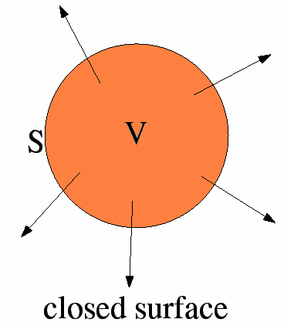
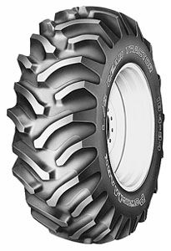
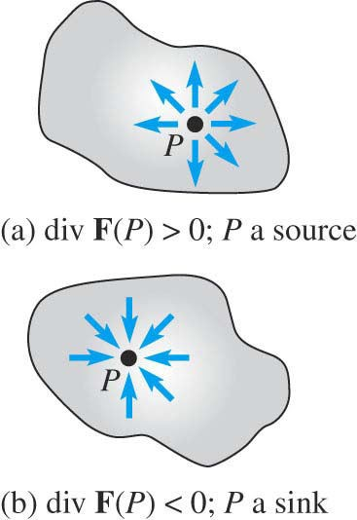
Divergence
Divergence is the outflow of flux from a small closed surface area (per unit volume) as volume shrinks to zero.
Air leaving a punctured tire: Divergence is positive, as closed surface (tire) exhibits net outflow
The divergence measures sources and drains of flow:
∇ ⋅ F(@ P) > 0 ⇒ source
∇ ⋅ F(@ P) < 0 ⇒ sink
∇ ⋅ F(@ P) = 0 ⇒ no source or sink
5

Slide 12
Physical Interpretation of the Divergence
Consider a vector field F that represents a fluid velocity:
The divergence of F at a point in a fluid is a measure of the rate at which the fluid is flowing away from or towards that point.
A positive divergence is indicating a flow away from the point.
Physically divergence means that either the fluid is expanding or that fluid is being supplied by a source external to the field.
The lines of flow diverge from a source and converge to a sink.
If there is no gain or loss of fluid anywhere then div F = 0. Such a vector field is said to be solenoidal.
The divergence also enters electrical engineering topics such as electric and magnetic fields:
For a magnetic field:∇ · B = 0, that is there are no sources or sinks of magnetic field, a solenoidal filed.
For an electric field:∇ · E = ρ/ε, that is there are sources of electric field..
6

Slide 13
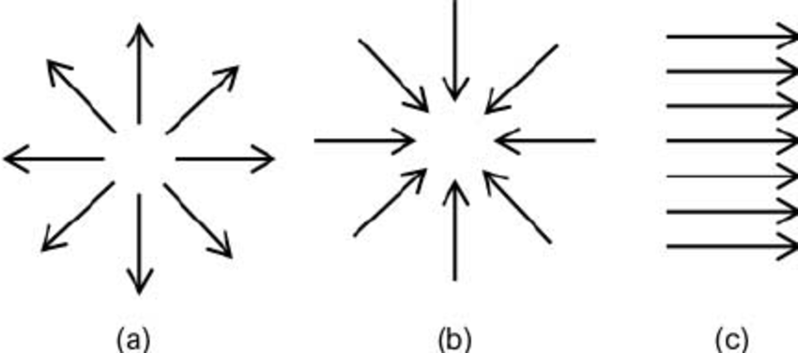

Slide 14
The Divergence of a Vector Field
Consider the vector fields
Vector function with two variable :
F(x, y) = P(x, y)^{ˆ}i + Q(x, y)^{ˆ}j
Vector function with three variable :
F(x, y, z) = P(x, y, z)^{ˆ}i + Q(x, y, z)^{ˆ}j + R(x, y, z)k^{ˆ}
We define the divergence of F
Div F = ^{∂P} + ^{∂Q} + ^{∂R}
∂x ∂y ∂z
In terms of the differential operator ∇, the divergence of F
Div F = ∇ • F = ^{∂P} + ^{∂Q} + ^{∂R}
∂x ∂y ∂z
A key point: F is a vector and the divergence of F is a scalar.
F = 4xyi^{ˆ} + (2x
2
+ 2 yz) ^{ˆ}j + 3(z + y )k^{ˆ}, Find ∇.F
Example:
2 2
4

Slide 15
https://youtu.be/vvzTEbp9lrc

Slide 17
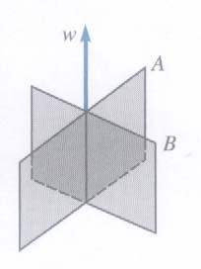
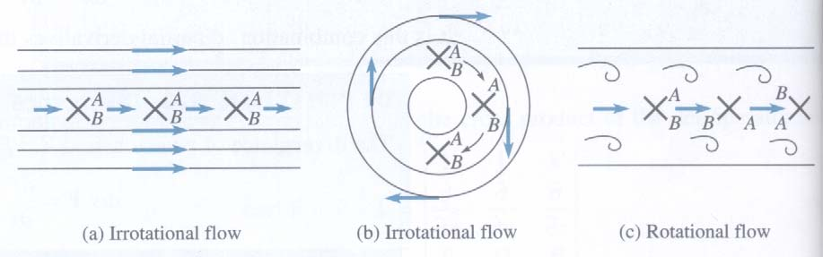
Physical Interpretations
Curl is easily understood in connection with the flow of fluids. If a paddle device, such as shown in fig, is inserted in a flowing fluid, the the curl of the velocity field F is a measure of the tendency of the fluid to turn the device about its vertical axis w.
If curl F = 0 then flow of the fluid is said to be irrotational. Which means that it is free of vortices or whirlpools that would cause the paddle to rotate.
Note: “irrotational” does not mean that the fluid does not rotate.

Slide 18
The Curl of a Vector Field
Consider the vector fields
F( x, y, z) = P( x, y, z)^{ˆ}i + Q( x, y, z)^{ˆ}j + R( x, y, z)k^{ˆ}
The curl of F is another vector field defined as:
i^{ˆ ˆ}j k^{ˆ}
∂ ∂ ∂
curl F =
∂x ∂y ∂z
P Q R
In terms of the differential operator ∇, the curl of F
Curl F = ∇ × F = ( ^{∂R} − ^{∂Q} )^{ˆ}i + ( ^{∂P} − ^{∂R} )^{ˆ}j + ( ^{∂Q} − ^{∂P} )k^{ˆ}
∂y ∂z ∂z ∂x ∂x ∂y
A key point: F is a vector and the curl of F is a vector.
Example: F = 4xyi^{ˆ} + (2x² + 2 yz) ^{ˆ}j + 3(z² + y² )k^{ˆ}, Find ∇ × F
7

Slide 19
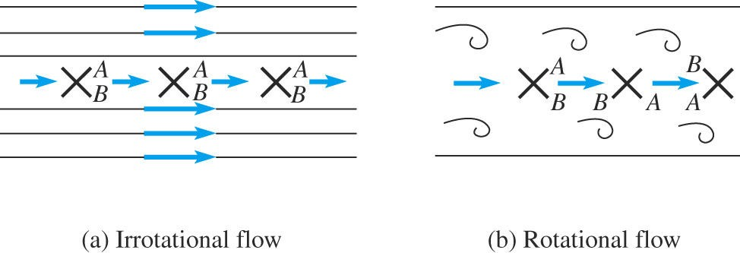
Physical Interpretation of the Curl
Consider a vector field F that represents a fluid velocity:
The curl of F at a point in a fluid is a measure of the rotation of the fluid.
If there is no rotation of fluid anywhere then ∇ x F = 0. Such a vector field is said to be irrotational or conservative.
For a 2D flow with F represents the fluid velocity, ∇ x F is
perpendicular to the motion and represents the direction of axis of rotation.
The curl also enters electrical engineering topics such as electric and magnetic fields:
A magnetic field (denoted by H) has the property ∇ x H = J.
An electrostatic field (denoted by E) has the property ∇ x E = 0,
an irrotational (conservative) field. Related Course:
Elec 251/351
8

Slide 20
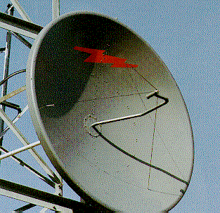
Vector Calculus and Electromagnetics
Maxwell equations in free space
Maxwell Equations describe the transmission of information ( internet data, TV/radio program, phone,…) using wireless communication.
∇ ⋅ E = ρ_{v} / ε₀ ,
∇ ⋅ B = 0,
∇ × E = −∂B / ∂t
∇ × B = μ₀J + ε₀∂E / ∂t
Solutions of this equations are essential for the analysis, design and advancement of wireless devices and system, high-speed electronics, microwave imaging, remote sensing, …etc.
Related Courses: ELEC251, ELEC351, ELEC353, ELEC453,
ELEC 456, ELEC 457

Slide 21
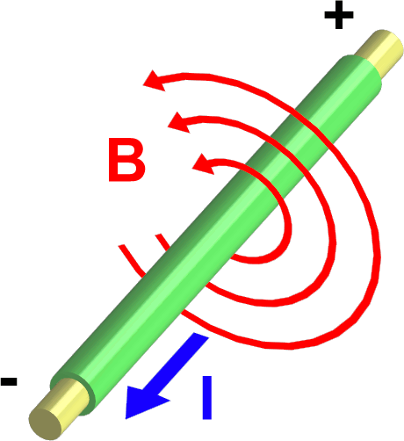
Magneto-static Field Example
Magneto-static Field is an example of rotational field
∇× B = J
∇× B = 0, outside the cable
∇× B ≠ 0, inside the cable

